Slide 1

Lunch & Learn: UiPath Exploration
Task Mining, Document Understanding
Sanuja Ratnarajah | Apr 3, 2024

Slide 2
TOC
01 Overview
02 Task Mining
About
Use Cases
Resources
03 Document Understanding
About
Use Cases
Resources
04 Next Steps

Slide 3
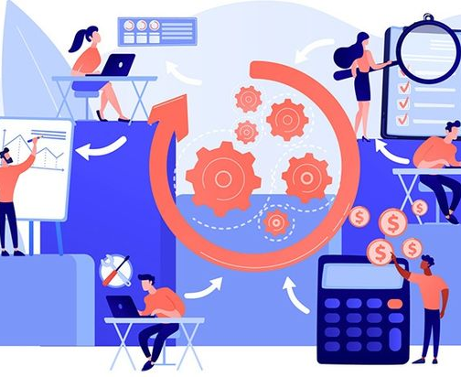
Task Mining
What is it?
A method of recording tasks in a business process to then analyze for process improvement & automation opportunities

Slide 4
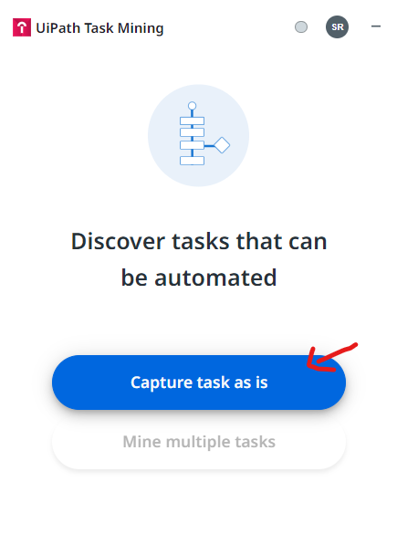
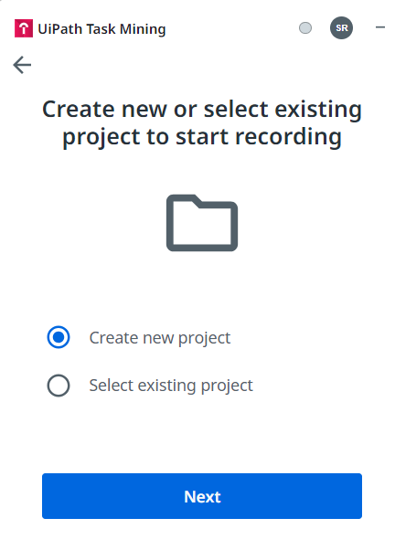
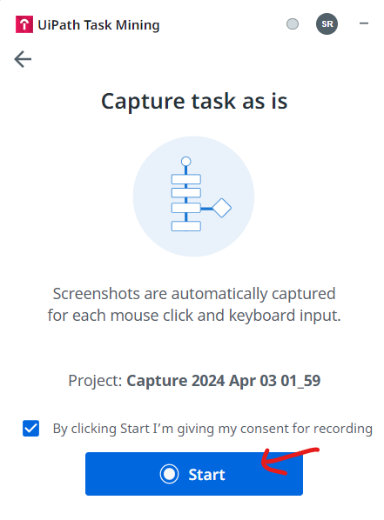
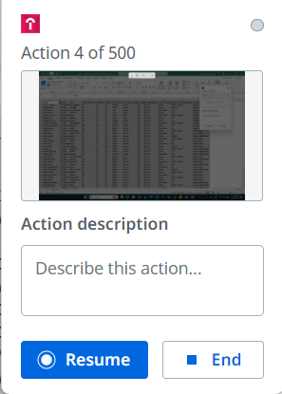
Task Mining
How It Works

Slide 5
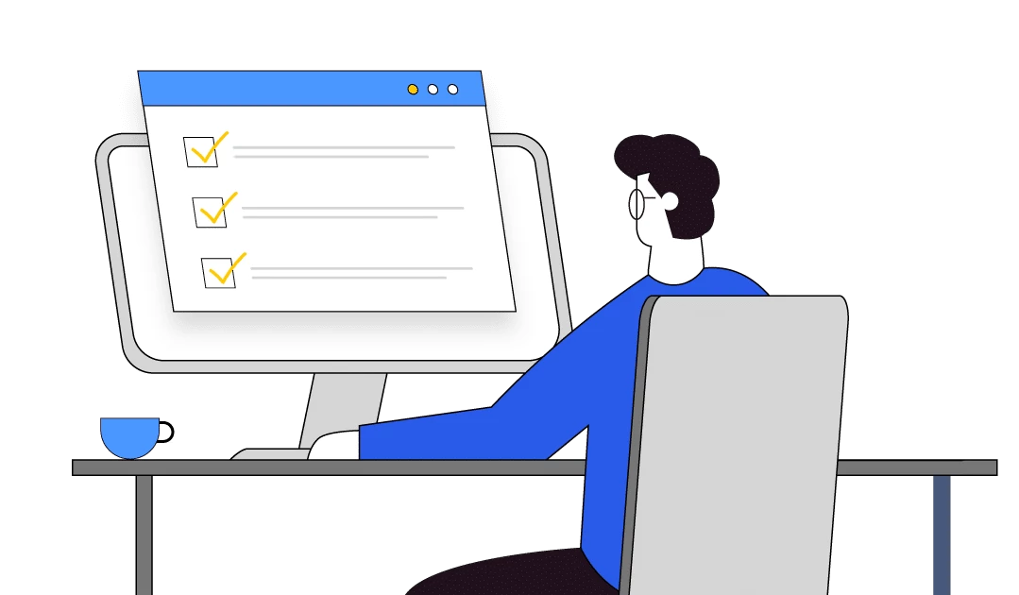
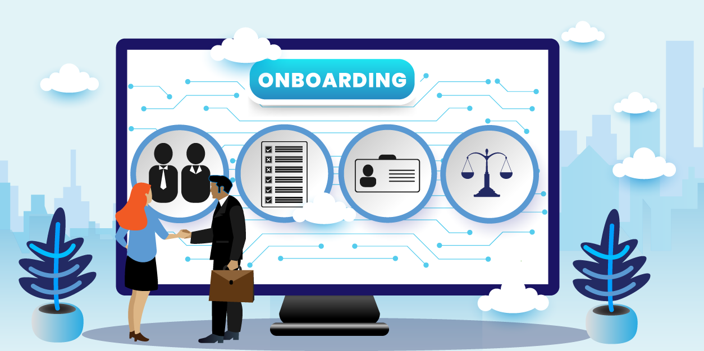
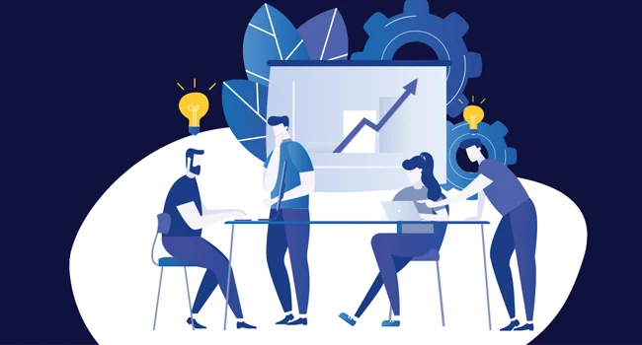
Use Cases
Process Discovery
Complex Workflows
Onboarding/Learning
Discovering processes that are not well documented/understood (ex: sprint planning based on company standards)
Interacting with multiple applications with multiple steps in each (ex: retrieving, analyzing survey data, and then sharing results)
Capturing tasks that can be used for training and learning purposes (ex: setting up payroll system for new employee)

Slide 6
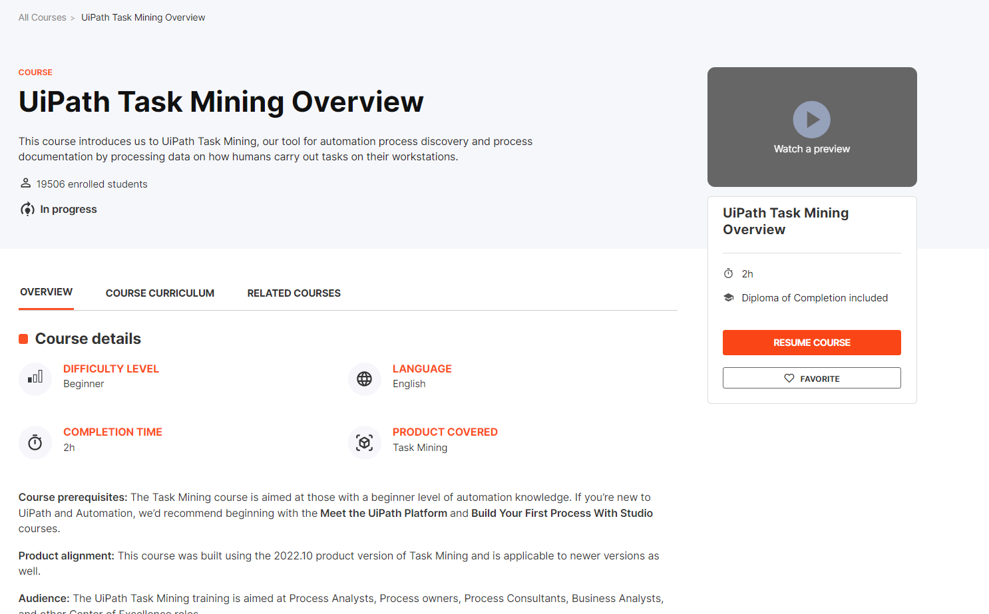
Task Mining
Want to learn more?
Check out UiPath Task Mining Overview on UiPath Academy

Slide 7
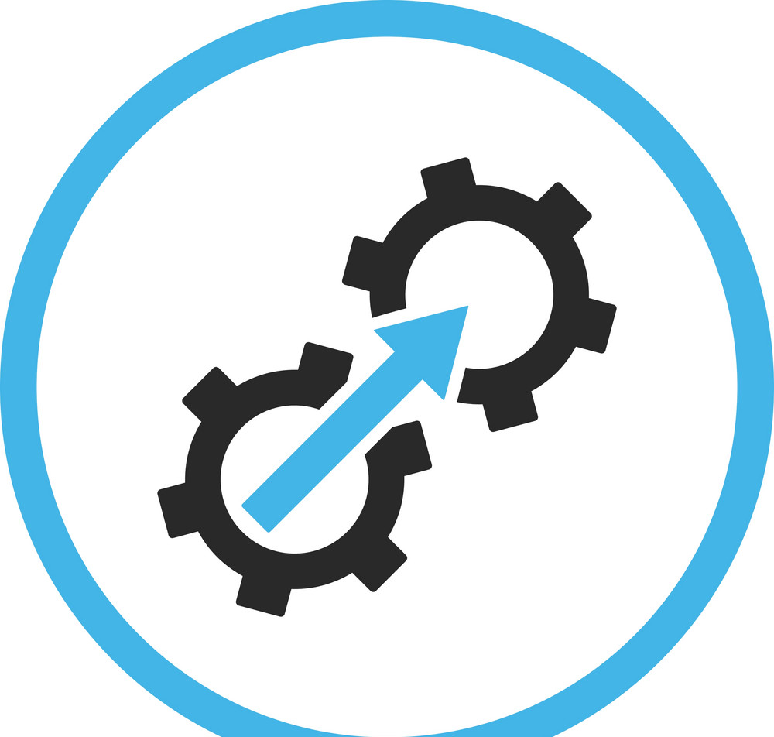


Document
Understanding
Feature used to intelligently extract, interpret, process data from PDFs, images, handwriting and other forms of media
All in one place - integrated with UiPath platform
Reduces time and costs spent on manual document processing
Mitigates risk of human error when processing

Slide 8
Document Understanding
How It Works
1
2
3
4
5
6
Load Taxonomy
Define files and data for extraction
Digitize
Use OCR to detect text and its location
Classify
Classify the documents from specified list
Extract
Extract information from documents
Validate
If needed, human can confirm extracted data
Export
Export extracted data for further use

Slide 9
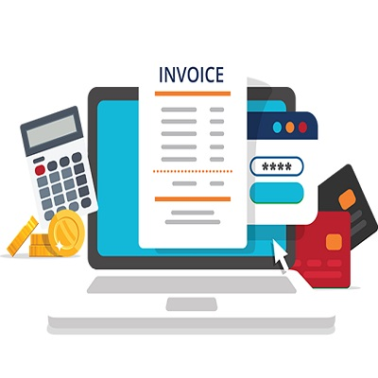
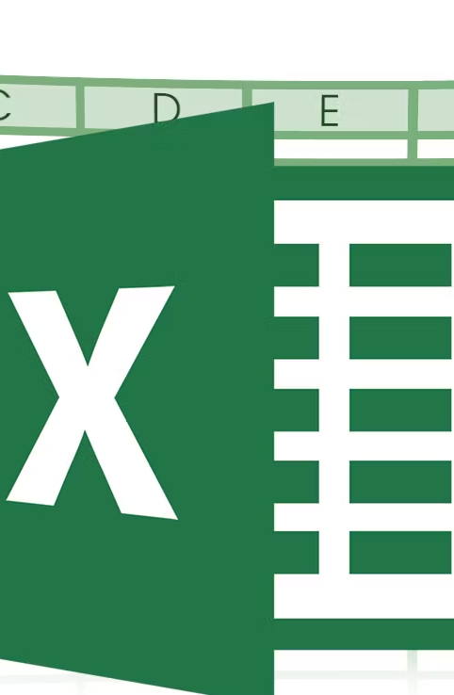
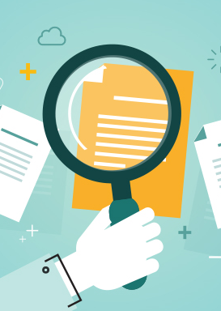
Use Case
01
02
03
Process invoice
Extract fields
Export to Excel

Slide 10
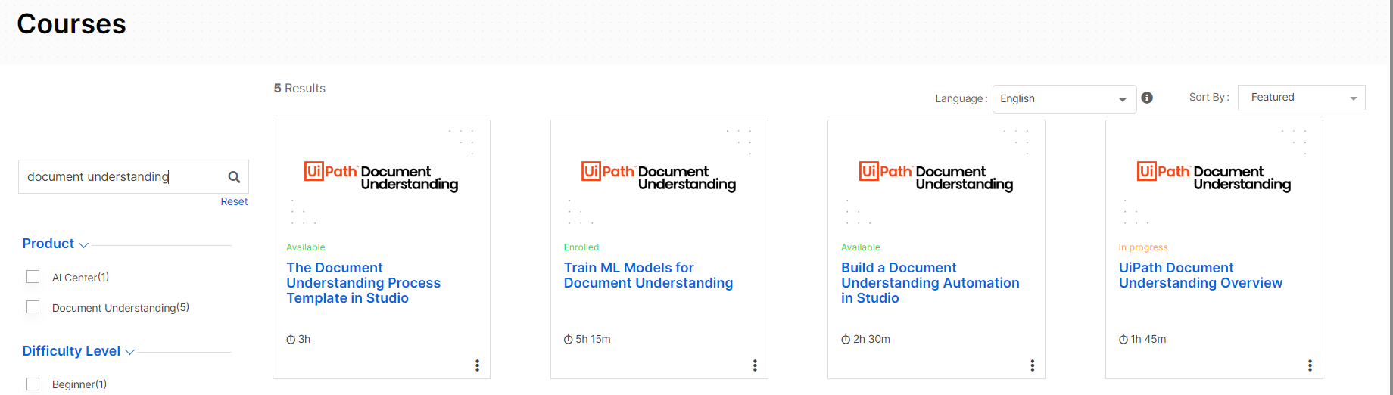
Document Understanding
Want to learn more? Check out these Document Understanding courses on UiPath Academy

Slide 11
What’s Next
Further explore task mining - unassisted for leveraging AI for further insights
Delve into other mining tools such as communications mining - compare with other features, build with business scenarios (ex: emails)
Further explore document understanding - experiment with more unstructured documents and layouts, build with new business scenarios

Slide 12
Thank you!

